Slide 1
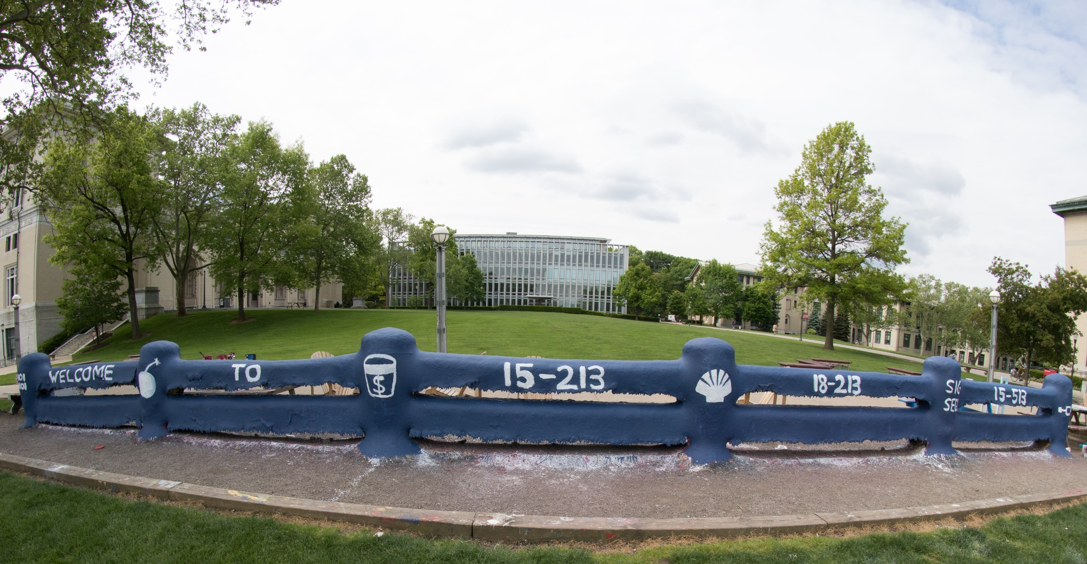
14-513
18-613

Slide 2
Design and Debugging 18-213/613: Introduction to Computer Systems 15th Lecture, October 22, 2024

Slide 3
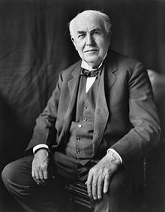
Bugs: You are in good company!
It has been just so in all of my inventions. The first step is an intuition, and comes with a burst, then difficulties arise—this thing gives out and [it is] then that "Bugs"—as such little faults and difficulties are called—show themselves and months of intense watching, study and labor are requisite before commercial success or failure is certainly reached.
-- Thomas Edison

Slide 4
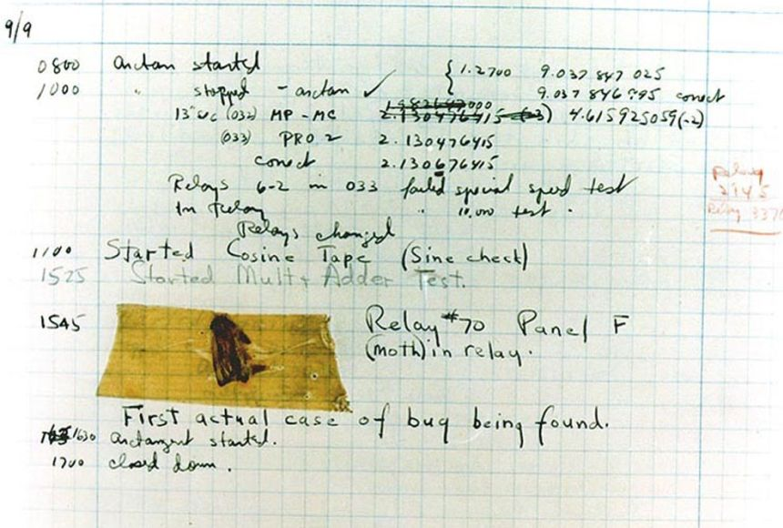

Bugs: You are in good company!
RADM Grace Hopper, PhD
Source: https://education.nationalgeographic.org/resource/worlds-first-computer-bug/

Slide 5

High Level View
(Expected)
Output
Input
Program
! Output
e.g.,
Error, Crash,
Wrong answer,
No response,
Input
Program
With Bug
Program
Step1
Step2
Step3

Slide 6

What is debugging?
! Output
e.g.,
Error, Crash,
Wrong answer,
No response,
Program
With Bug
Given as
Input
+
Produce the
Location, source of
Defect and
A potential fix!
Step2

Slide 7
Debugging
Art and science of fixing bugs in software engineering systems
Where is the bug?
When does it occur? What triggers it?
How can we repair it?

Slide 8
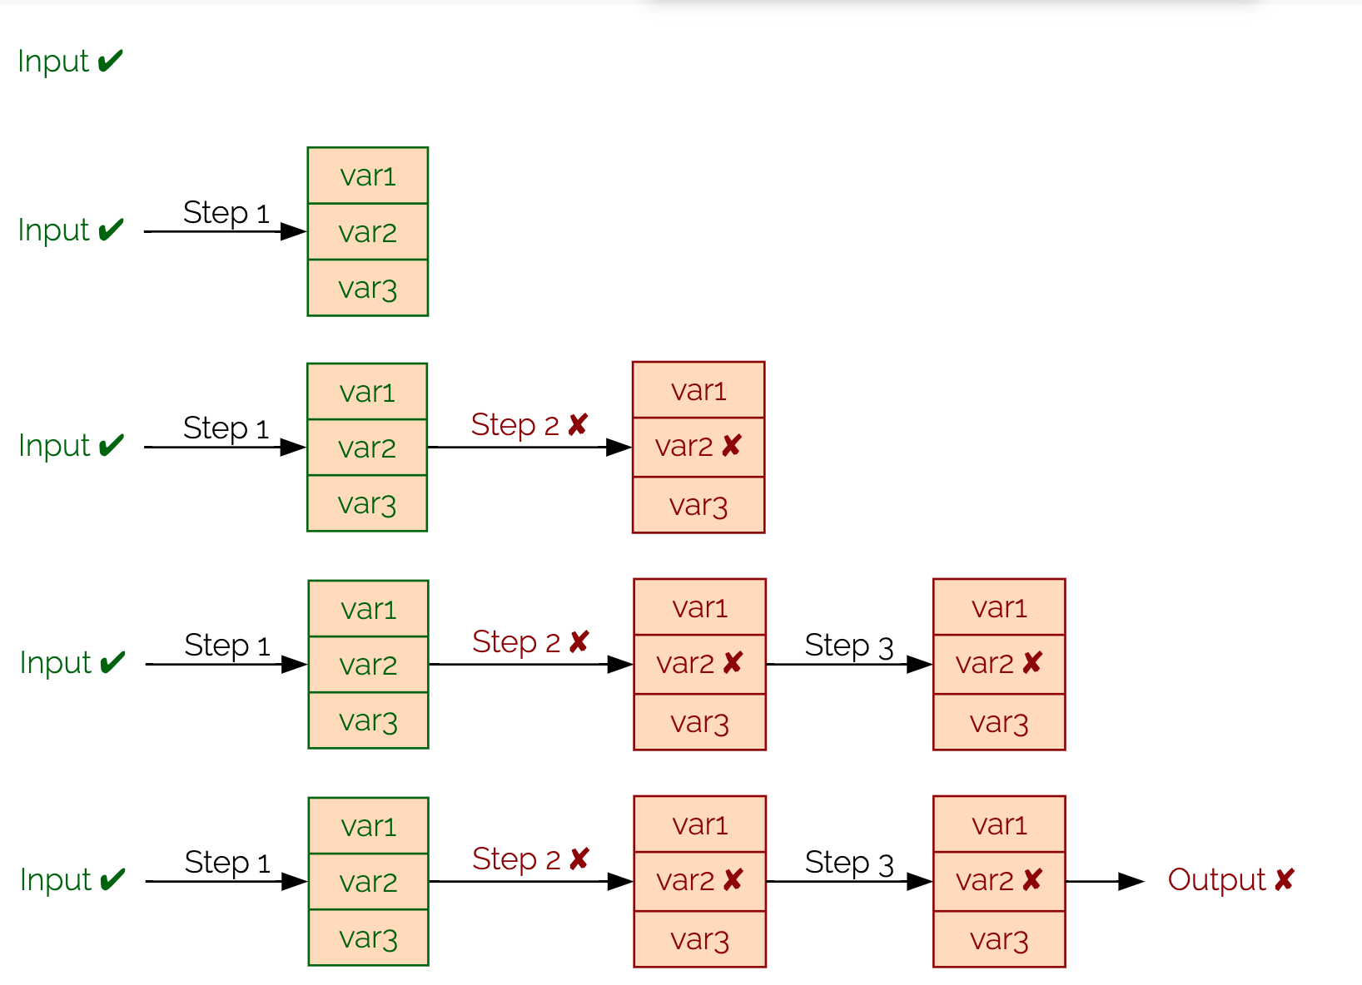
Defects, Propagation, & Failures
Defect
Fault Propagation
Fault
Failure
https://www.debuggingbook.org/html/Intro_Debugging.html

Slide 9
Caveat: Curse of Debugging
Testing can only show the presence of errors – not their absence. (Dijkstra 1972)
Not every defect causes a visible/observable failure!
Fortunately, most failures can be traced back to the defect that causes it!

Slide 10
Debugging is hard, make no mistake!
Program “states” are large
Executions can have multiple steps
Defects/errors could be subtle
Defects/errors only triggered for some edge inputs!
Other factors: concurrency, randomization, distributed state, …

Slide 11
How do you make progress if its hard?
Scientific hypothesis testing
Meta: Problem solving strategies to generate hypothesis/leads
Tools to prune search space and collect data
“Rubberducking”
..

Slide 12
Scientific Process for Hypothesis Testing
Problem Report
Code
Example traces
Hypothesis
If Evidence Concurs
Fix or
Refine Hypothesis!
Else
Seek alternative
Collect more runs
Check expt for error
Prediction
Experiment
Observation

Slide 13

Meta : Art of Problem Solving
Can you restate the problem in your own words?
Can you think of a picture or a diagram that might help you understand the problem?
Is there enough information to enable you to find a solution?
Understand
Guess and check
Consider special cases
Solve a simpler problem
Divide and conquer
…
Make a Plan
Grit/Persevere ☺
Execute the Plan
Look back on your work
Did you solve all edge cases/
Was there a better fix?
Was there a quicker bug finding?

Slide 14
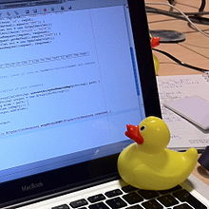
Meta: Good practices
“Visualize” the problem/Whiteboard/Ipad
Keep a log!
Explain the problem to someone else. Even more important is that you are explaining the problem to yourself
“Sometimes it takes no more than a few sentences, followed by an embarrassed "Never mind. I see what's wrong. Sorry to bother you.” [Kernighan 1999]

Slide 15
Occam’s Razor
“The simplest explanation is often the best one.”
Before diving in too deeply, take a step back, take a breadth:
What are the symptoms?
Under what circumstance(s) do they occur?
Is the situation completely within the design envelop?
What code is responsible for this/these circumstance(s)?
Look there first.
Look for more distant explanations only after verifying that the invariants are met and that that the bug isn’t local to the code exhibiting it or the most likely places for things to have become tainted.

Slide 16
Walkthrough: Code with a Bug
int fib(int n)
{
int f, f0 = 1, f1 = 1;
while (n > 1) {
n = n - 1;
f = f0 + f1;
f0 = f1;
f1 = f;
}
return f;
} int main(..) { .. for (i = 9; i > 0; i--) printf(“fib(%d)=%d\n”, i, fib(i));
$ gcc -o fib fib.c fib(9)=55 fib(8)=34 ... fib(2)=2 fib(1)=134513905
A defect has caused a failure.
Notes:
Simple example to illustrate techniques.
Students do not need to know the code or find the bug.

Slide 17
Hypothesis1
Hypothesis2
Prediction
Prediction
Experiment
Experiment
Observation
Observation

Slide 18
Constructing a Hypothesis
Specification defined the first Fibonacci number as 1
We have observed working runs (e.g., fib(2))
We have observed a failing run
We then read the code
fib(1) failed // Hypothesis
Code | Hypothesis
for (i = 9; …) | Result depends on order of calls
while (n > 1) { | Loop check is incorrect
int f; | F is uninitialized
Notes:
What is the input to the hypothesis?
Propose three possible hypotheses from the code.

Slide 19
Observation
What is the observed result?
Factual observation, such as “Calling fib(1) will return 1.”
The conclusion will interpret the observation(s)
Don’t interfere.
printf() can interfere
Like quantum physics, sometimes observations are part of the experiment
Proceed systematically.
Update the conditions incrementally so each observation relates to a specific change
Do NOT ever proceed past first bug.

Slide 20

Debugging Tools
Observing program state can require a variety of tools
Debugger (e.g., gdb)
What state is in local / global variables (if known)
What path through the program was taken
Valgrind
Does execution depend on uninitialized variables
Are memory accesses ever out-of-bounds
Notes:
Image: https://thumbs.dreamstime.com/m/sherlock-holmes-cartoon-vector-14725610.jpg (from a search for pubic domain images)

Slide 21
Diagnosis
A scientific hypothesis that explains current observations and makes future predictions becomes a theory
We’ll call this a diagnosis
Use the diagnosis to develop a fix for the defect
Avoid post hoc, ergo propter hoc fallacy
Or correlation does not imply causation
Understand why the defect and fix relate
Notes:
Fallacy commonly seen in malloc lab. If I add a printf to this code, then it works at –O3. Actual problem is that there is undefined behavior and the printf function call reduced the optimization space.
Story: “Once there was a program that only worked on Wednesday. The spec had declared that days are at most 8 characters long. Wednesday is 9 (+ NULL). The NULL was initializing another field so the program would only then operate correctly.”

Slide 22
Fix and Confirm
Confirm that the fix resolves the failure
If you fix multiple perceived defects, which fix was for the failure?
Be systematic

Slide 23
Learn
Common failures and insights
Why did the code fail?
What are my common defects?
Assertions and invariants
Add checks for expected behavior
Extend checks to detect the fixed failure
Testing
Every successful set of conditions is added to the test suite
Notes:
- Prof Railing says, “I don’t use certain C syntax in my code as I know I am prone to errors if I do.”
- Are there internal conditions to check for (invariants)? External (tests)?

Slide 24
Quick and Dirty
Not every problem needs scientific debugging
Set a time limit: (for example)
0 minutes – -Wall, valgrind
1 – 10 minutes – Informal Debugging
10 – 60 minutes – Scientific Debugging
> 60 minutes – Take a break / Ask for help

Slide 25
Common bugs (not comprehensive)
Common ways in which code is likely to have bugs,
either already or in the future
Use of uninitialized variables
Unused values
Unreachable code
Duplicated code
Bloated functions/methods
Memory leaks
Interface misuse
Null pointers
Notes:
Common bugs, many of which can be detected by compilers or existing tools.

Slide 26
Outline
Caches (review of previous lecture)
Using blocking to improve temporal locality
Debugging
Defects and Failures
Scientific Debugging
Tools
Design
Managing complexity
Communication
Naming
Comments

Slide 27
Design
A good design needs to achieve many things:
Performance
Availability
Modifiability, portability
Scalability
Security
Testability
Usability
Cost to build, cost to operate
Notes:
From these many objectives, we will summarize into two points.

Slide 28
Design
A good design needs to achieve many things:
Performance
Availability
Modifiability, portability
Scalability
Security
Testability
Usability
Cost to build, cost to operate
But above all else: it must be readable
Notes:
From these many objectives, we will summarize into two points.

Slide 29
Design
Good Design does:
Complexity Management &
Communication
Notes:
IF a design does these things and solves the problem, then it can also achieve (or be extended to achieve) the other objectives

Slide 30
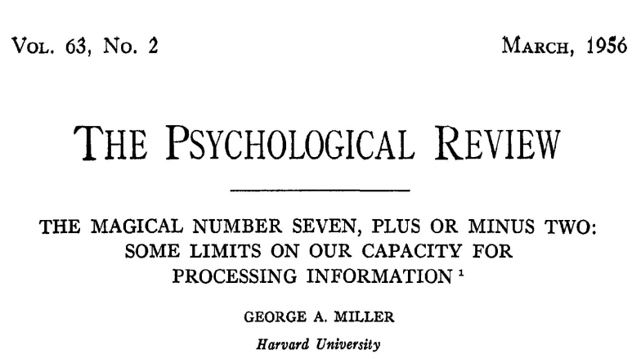
Complexity
There are well known limits to how much complexity a human can manage easily.

Slide 31
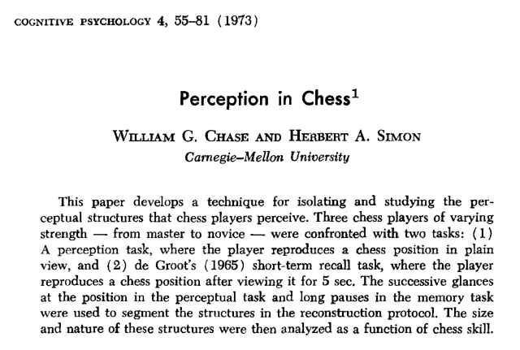
Complexity Management
However, patterns can be very helpful...

Slide 32
Complexity Management
Many techniques have been developed to help manage complexity:
Separation of concerns
Modularity
Reusability
Extensibility
Abstraction
Information Hiding
...
Notes:
This is a lot and the list is beyond the scope of the course. Next slide is the 200-level suggestion(s)

Slide 33
Complexity Management: Step 0
Make a plan!
Break down the complex problem into simpler chunks
Visualize or whiteboard the system “architecture” and key “functions” before writing any code!
Write example test cases/traces even before coding!
Notes:
This is a lot and the list is beyond the scope of the course. Next slide is the 200-level suggestion(s)

Slide 34
Managing Complexity
Given the many ways to manage complexity
Design code to be testable
Try to reuse testable chunks
Notes:
To start managing complexity, split

Slide 35
Complexity Example
Split a cache access into three+ testable components
State all of the steps that a cache access requires
Convert address into tag, set index, block offset
Look up the set using the set index
Check if the tag matches any line in the set
If so, hit
If not a match, miss, then
Find the LRU block
Evict the LRU block
Read in the new line from memory
Update LRU
Update dirty if the access was a store
Which steps depend on the operation being a load or a store?
Notes:
I would have students talk to their neighbors for a few minutes about these steps

Slide 36
Complexity Example
Split a cache access into three+ testable components
State all of the steps that a cache access requires
Convert address into tag, set index, block offset
Look up the set using the set index
Check if the tag matches any line in the set
If so, hit
If not a match, miss, then
Find the LRU block
Evict the LRU block
Read in the new line from memory
Update LRU
Update dirty if the access was a store
Which steps depend on the operation being a load or a store?
Notes:
I would have students talk to their neighbors for a few minutes about these steps
Convert address can also be multiple steps
This is just one example sequence

Slide 37
Designs need to be testable
Testable design
Testing versus Contracts*
These are complementary techniques
Testing and Contracts are
Acts of design more than verification
Acts of documentation: executable documentation!
* A contract specifies in a precise and checkable way interfaces for software components: preconditions, postconditions, and object invariants.

Slide 38
Testing Example
For your cache simulator, you can write your own traces
Write a trace to test for a cache hit
L 50, 1 L 50, 1
Write a trace to test dirty bytes in cache
S 100, 1

Slide 39
Testable design is modular
Modular code has: separation of concerns, encapsulation, abstraction
Leads to: reusability, extensibility, readability, testability
Separation of concerns
Create helper functions so each function does “one thing”
Functions should neither do too much nor too little
Avoid duplicated code
Encapsulation, abstraction, and respecting the interface
Each module is responsible for its own internals
No outside code “intrudes” on the inner workings of another module

Slide 40
Trust the Compiler!
Use plenty of temporary variables
Use plenty of functions
Let compiler do the math

Slide 41
Communication
When writing code, the author is communicating with:
The machine
Other developers of the system
Code reviewers
Their future self
Notes:
We communicate with different audiences.

Slide 42
Communication
There are many techniques that have been developed around code communication:
Tests
Naming
Comments
Commit Messages
Code Review
Design Patterns
...
Notes:
We communicate through many means

Slide 43
Naming

Slide 44
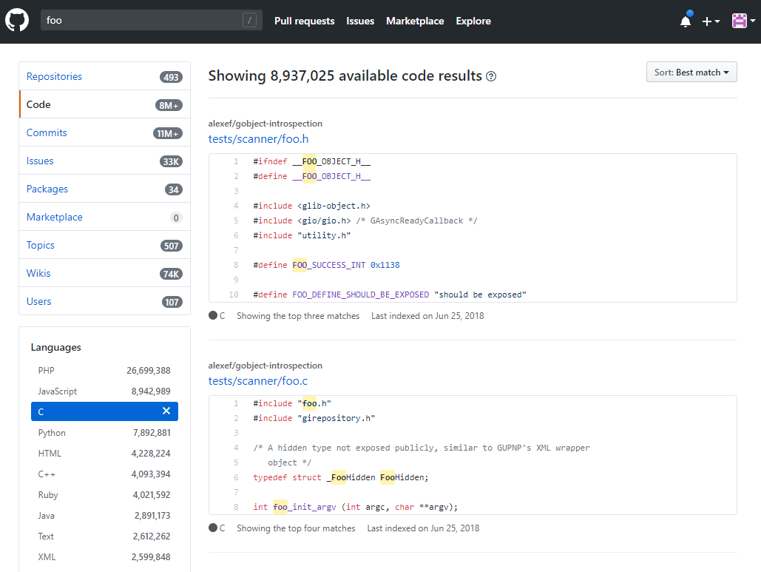
Avoid deliberately meaningless names:

Slide 45
Naming is understanding
“If you don’t know what a thing should be called, you cannot know what it is.
If you don’t know what it is, you cannot sit down and write the code.” - Sam Gardiner

Slide 46
Better naming practices
Start with meaning and intention
Use words with precise meanings (avoid “data”, “info”, “perform”)
Prefer fewer words in names
Avoid abbreviations in names
Use code review to improve names
Read the code out loud to check that it sounds okay
Actually rename things
Notes:
Yes, the 213 course-staff is guilty of transgressing many of these suggestions

Slide 47
Naming guidelines – Use dictionary words
Only use dictionary words and abbreviations that appear in a dictionary.
For example: FileCpy -> FileCopy
Avoid vague abbreviations such as acc, mod, auth, etc..

Slide 48
Avoid using single-letter names
Single letters are unsearchable
Give no hints as to the variable’s usage
Exceptions are loop counters
Especially if you know why i, j, etc were originally used
Notes:
See https://en.wikibooks.org/wiki/Fortran/Fortran_variables

Slide 49
Limit name character length
“Good naming limits individual name length, and reduces the need for specialized vocabulary” – Philip Relf

Slide 50
Limit name word count
Keep names to a four word maximum
Limit names to the number of words that people can read at a glance.
Which of each pair do you prefer?
a1) arraysOfSetsOfLinesOfBlocks
a2) cache
b1) evictedData
b2) evictedDataBytes
Notes:
Bpr: “My friend wrote the following line in C++. This data structure tracked the coherence state in a simulator. I still wonder if he could have done better
map<uint, map<ContextId, map<ContextId, map<uint, uint> > > > theDataStructureWhichShallNotBeNamed;”

Slide 51
Describe Meaning
Use descriptive names.
Avoid names with no meaning: a, foo, blah, tmp, etc
There are reasonable exceptions:
void swap(int* a, int* b) {
int tmp = *a;
*a = *b;
*b = tmp;
}
Notes:
Tmp is fine when it really is short-lived and temporary.

Slide 52
Use a large vocabulary
Be more specific when possible:
Person -> Employee
What is size in this binaryTree?
struct binaryTree {
int size;
…
};
height
numChildren
subTreeNumNodes
keyLength
Notes:
Discuss size. Could be height of tree, number of nodes, memory usage, etc.

Slide 53
Use problem domain terms
Use the correct term in the problem domain’s language.
Hint: as a student, consider the terms in the assignment
In cachelab, consider the following:
line
element

Slide 54
Use opposites precisely
Consistently use opposites in standard pairs
first/end -> first/last

Slide 55
Comments

Slide 56
Don’t Comments
Don’t say what the code does
because the code already says that
Don’t explain awkward logic
improve the code to make it clear
Don’t add too many comments
it’s messy, and they get out of date

Slide 57
Awkward Code
Imagine someone (TA, employer, etc) has to read your code
Would you rather rewrite or comment the following?
How about?
Both lines update program state in the same way.
(*(void **)((*(void **)(bp)) + DSIZE)) = (*(void **)(bp + DSIZE));
bp->prev->next = bp->next;
Notes:
Old malloc example, published in SIGCSE by Railing and Bryant.

Slide 58
Do Comments
Answer the question: why the code exists
When should I use this code?
When shouldn’t I use it?
What are the alternatives to this code?

Slide 59
Why does this exist?
Explain why a magic number is what it is.
When should this code be used? Is there an alternative?
// Each address is 64-bit, which is 16 + 1 hex characters
const int MAX_ADDRESS_LENGTH = 17;
unsigned power2(unsigned base, unsigned expo){
unsigned i;
unsigned result = 1;
for(i=0;i<expo;i++){
result+=result;
}
return result;
}
Notes:
The power2 code is from a student’s submission.

Slide 60
How to write good comments
Write short comments of what the code will do.
Single line comments
Example: Write four one-line comments for quick sort
// Initialize locals
// Pick a pivot value
// Reorder array around the pivot
// Recurse
Notes:
Students are notorious for writing comments last, so emphasize that brief comments of the design comes before implementation.

Slide 61
How to write good comments
Write short comments of what the code will do.
Single line comments
Example: Write four one-line comments for quick sort
Write that code.
Revise comments / code
If the code or comments are awkward or complex
Join / Split comments as needed
Maintain code and comments

Slide 62
Commit Messages
Committing code to a source repository is a vital part of development
Protects against system failures and typos:
cat foo.c versus cat > foo.c
The commit messages are your record of your work
Communicating to your future self
Describe in one line what you did
“Parses command line arguments”
“fix bug in unique tests, race condition not solved”
“seg list finished, performance is …”
Use branches
Notes:
The cat example will silently truncate the file to be empty.

Slide 63
Summary
Programs have defects
Be systematic about finding them
Programs are more complex than humans can manage
Write code to be manageable
Programming is not solitary, even if you are communicating with a grader or a future self
Be understandable in your communication

Slide 64
Acknowledgements
https://www.debuggingbook.org/
Some debugging content derived from:
http://www.whyprogramsfail.com/slides.php
Some code examples for design are based on:
“The Art of Readable Code”. Boswell and Foucher. 2011.
Lecture originally written by
Michael Hilton and Brian Railing

